Slide 1

Cross-Sentiment Analysis of Literature Sources using BERT
Capstone Project Phase A 23-2-R6
Authors:
Omer Asus 205923717
Alon Modin 316567585
Advisors:
Dr. Renata Arvos
Prof. Zeev Volkovich

Slide 2
Contents
Problem Definition
BERT
CNN
Encoders
Working Flow
Graphical User Interface

Slide 3
Problem Definition

Slide 4
Identifying Text Writers through Writing Style Analysis
Introduction :
Objective: Identify text writers by analyzing their unique authorship style
Methodology: Analyze tweet-like texts using sentiment analysis methodology

Slide 5
Identifying Text Writers through Writing Style Analysis
Methodology :
Challenge: Applying of sentiment analysis approach to differentiating authorships
Solution: Employ a BERT-based aspect-level sentiment analysis algorithm
Benefits of BERT: Contextual understanding and capturing language nuances

Slide 6
Identifying Text Writers through Writing Style Analysis
Dataset and Model Development:
Translate long texts to short as tweets batches
Exploit BERT as the backbone for discerning and classifying tweet-like text
Potential Applications: Author profiling, opinion mining, and social media analysis

Slide 7
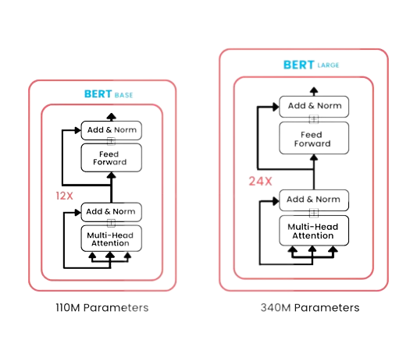
BERT

Slide 8
BERT: Advancing Natural Language Processing
Introduction :
BERT (Bidirectional Encoder Representations from Transformers)
Significance: Revolutionized deep learning in natural language processing (NLP)
Key feature: Capturing contextual information bidirectionally

Slide 9
BERT: Advancing Natural Language Processing
Pre-training Phase:
Masked Language Model:
Model: Randomly masking tokens and predicting them based on context
Learning relationships between words within a sentence
Next Sentence Prediction:
Understanding sentence-level relationships
Capturing dependencies between sentences

Slide 10
BERT: Advancing Natural Language Processing
Fine-tuning and Transfer Learning:
Fine-tuning BERT for specific tasks:
Adding task-specific layers and optimizing on task-specific datasets
Examples: Text classification, named entity recognition, question answering
Knowledge transfer:
Leveraging learned representations for downstream tasks
Achieving state-of-the-art performance in NLP benchmarks

Slide 11
CNN

Slide 12
Convolutional Neural Networks (CNNs) for Image Processing
Introduction :
Purpose: Process and analyze images
Composition: Convolutional layers, pooling layers, fully connected layers
Advantages: Automatic feature extraction, handling large-scale data

Slide 13
Convolutional Neural Networks (CNNs) for Image Processing
Functionality :
Convolutional Layers:
Extract features from images
Capture patterns and spatial information
Pooling Layers:
Reduce spatial dimensions, preserve important information
Achieve spatial invariance and robustness
Fully Connected Layers:
Connect extracted features to a classifier
Perform high-level reasoning and classification

Slide 14
Encoders

Slide 15
Encoders in Deep Learning
Definition: Encoders transform input data into compressed representations.
Purpose: Reduce complexity and extract important information.
How it works:
Input Data
Extract Features
Capture Patterns

Slide 16
Purpose of Encoders
Feature Extraction: Identify relevant patterns and information.
Dimensionality Reduction: Condense data while retaining key characteristics.
Representation Learning: Learn abstract and meaningful representations.
Benefits: Improved performance and generalization in complex tasks.

Slide 17
Working Flow

Slide 18
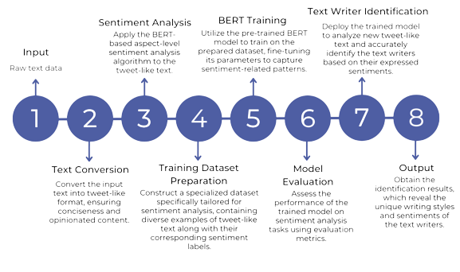

Slide 19
Graphical User Interface

Slide 20
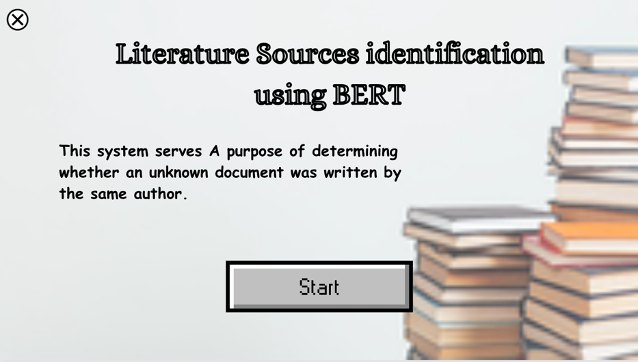
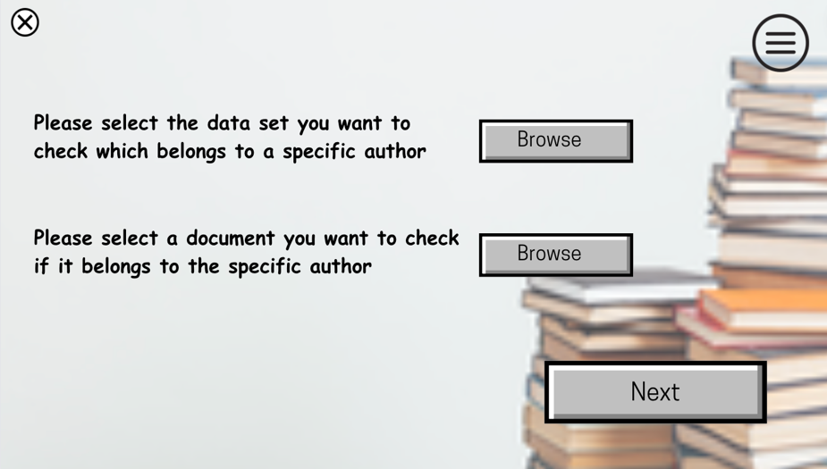
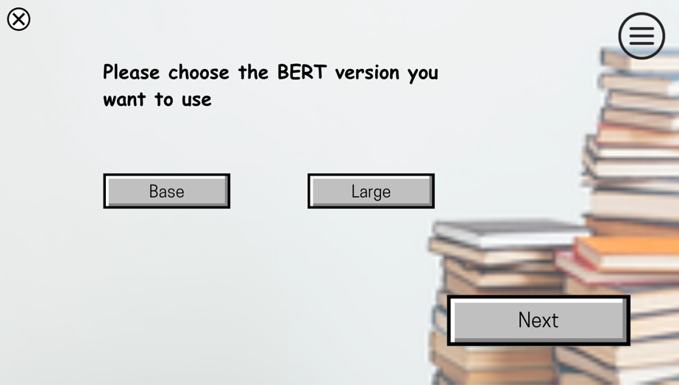
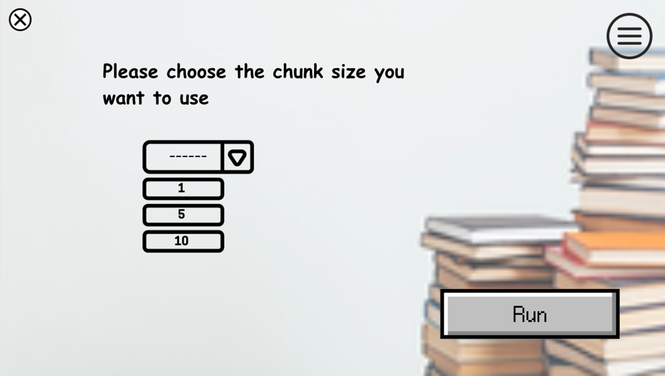

Slide 21
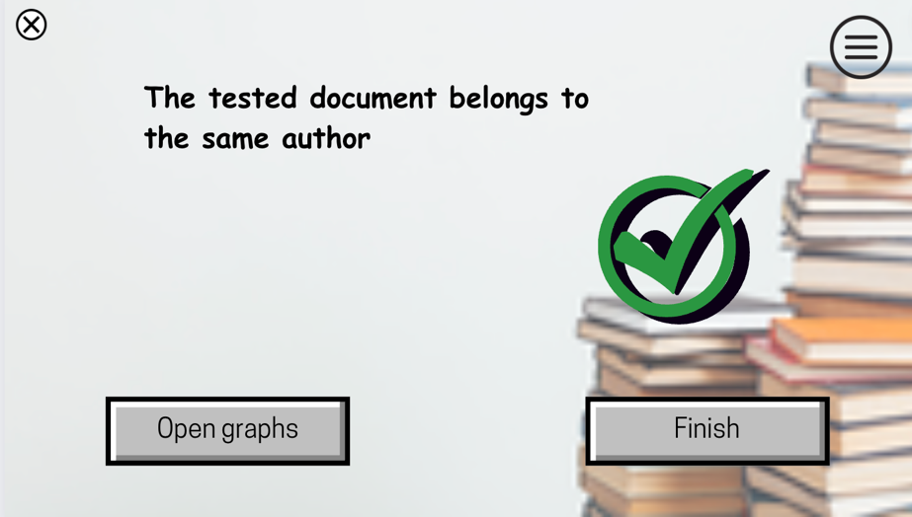
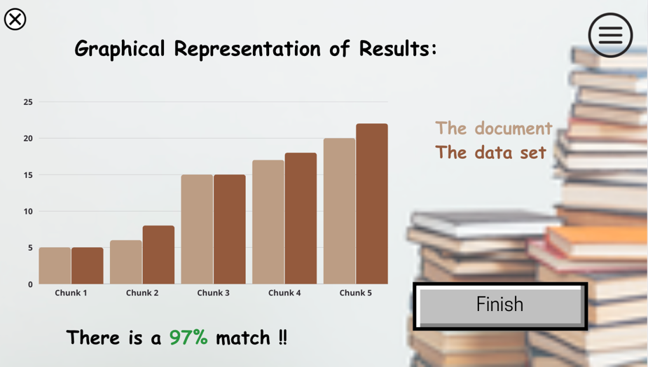
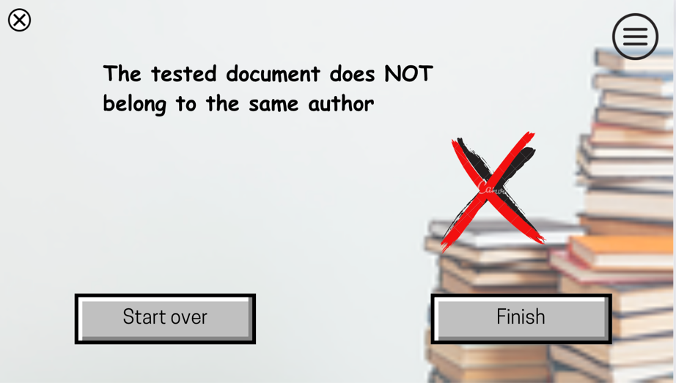

Slide 22


